Slide 1
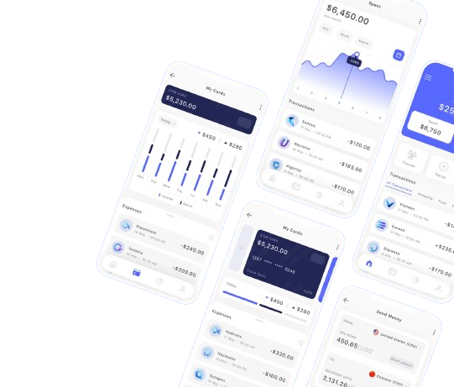

The Digital Customer Experience Launch
Train the Trainer – Internal Briefing
Notes:
Purpose: Align stakeholders on the why, what, how, and enablement strategy supporting the new customer app launch.
Talk track:
This briefing is the first step in a three-part enablement journey: understand, practice, validate.
It’s designed to prepare you, as trainers, to support a new digital customer experience. It’s not a feature walkthrough - it’s about ensuring frontline teams are ready to guide customers confidently through change.
Presenter Notes
Who this is for: trainers, not frontline
What this is not: not a feature demo
Why this matters now: digital exp airmarked to launch next quarter

Slide 2
Why We’re Doing This
Launching a new customer-facing digital experience
Frontline confidence is critical to customer trust and adoption
Customers will look to frontline teams for reassurance and guidance
Notes:
We’ve learned from past launches that the biggest risk isn’t the technology - it’s what happens when customers ask questions before we’re ready, escalations rise & confidence drops/
This initiative is about preventing that before customers feel it.
Talk track
We’re launching a new digital experience that will raise questions for customers. When that happens, they turn to frontline teams. Our goal is to ensure those teams feel confident because customer trust is built in those moments
Emphasize:
Proactive, not reactive framing
Customer reassurance as a core goal
Avoid operational detail

Slide 3
The Problems We’re Solving
Generic training does not reflect real customer scenarios
Limited opportunity to practice conversations before launch
Knowledge fragmented across product, support, and operations
Frontline teams learn under pressure once customers are already impacted
Notes:
This is a readiness and enablement gap, not a performance issue.
Talk track:
Teams are often unprepared for objections around confidence, capability, and trust. Traditional training doesn’t prepare teams for real conversations. Customers bring concerns and hesitation, and without practice, frontline teams are often learning in live situations
- Validate frontline experience
- Stress emotional pressure, not skill gaps
- Do not jump ahead to solutions yet

Slide 4
What We’re Launching
A new customer app designed to simplify key actions
Introduces new workflows, terminology, and expectations
Customer adoption will vary
Notes:
Talk track:
This launch changes how customers interact with us.
Based on past product rollouts, we have seen that some customers will adopt quickly, others may hesitate, both reactions are expected.
What matters is how well we support customers at their own pace.
Presenter notes:
- Normalize mixed customer reactions
- Present adoption variability as expected, not problematic
- Emphasize support quality over adoption speed

Slide 5
How We’re Solving It
Practice-based learning aligned to launch scenarios
Training with support materials: FAQs, screenshots, escalation paths
AI-powered simulations for safe practice
Guidance on advocating benefits while respecting customer readiness
Notes:
Talk track:
Instead of relying on passive training, we’re focusing on practice. Teams will rehearse real customer conversations using the same materials they’ll rely on after launch - in a safe environment.
Presenter notes:
- Contrast practice vs theory
- Emphasize safe failure (CAISY’s_

Slide 6
Frontline Enablement Plan
Train-the-trainer sessions
Role-specific Skill Benchmark assessments
AI-powered role-play for customer and support scenarios
Just-in-time post-launch resources
Trainer focus: Prepare teams to guide, reassure, or redirect when needed
Notes:
Talk Track
The aim is to create confident guides, your role as trainers is to help frontline teams know when to encourage digital use, when to reassure customers, and when to redirect to other support options.
Presenter Notes
- Trainer accountability is key here
- Avoid framing benchmarks as punitive

Slide 7
Impact & Measurement
Operational impact:
Faster frontline readiness
Fewer avoidable escalations
More consistent customer messaging
Improved customer confidence
Measurement:
Skill Benchmark proficiency scores
AI-Simulation performance insights
Early post-launch support trends
Notes:
Talk track:
We’re aiming for operational impact - faster readiness, fewer escalations, and more consistent conversations.
To understand how we’re doing, we’ll use a combination of skill benchmarks, simulation insights, and early support trends.
Presenter notes:
- Emphasize trends over individual scores
- Frame measurement as feedback, not evaluation
- Avoid language that suggests pass/fail outcomes

Slide 8
How This Will Be Used
Share internal source of truth
Enables trainer alignment and readiness
Followed by AI-simulations and skill validation
Updated as the digital experience evolves
Notes:
Talk track:
This briefing is the foundation. What follows — simulations, benchmarks, and ongoing updates - is where confidence is built and maintained over time
Presenter Notes
- Reinforce continuity
- Position this as living enablement

